Slide 1
Ramón
Nicolas
Alba Madera Rivero

Slide 2
Ramón Nicolas
Degree in Galician-Portuguese Philology (University of Santiago de Compostela, 1989).

Slide 3
01
02
03
04
He teaches Galician language and literature at a public secondary school in Vigo.
He has taught at the University of Vigo and has been a literary critic since 1990.
He has collaborated in several written and audiovisual media and currently collaborates in the 'Culturas' supplement of La Voz de Galicia.
He is also responsible for the "Breviario" section of the magazine 'Biblos'.

Slide 4
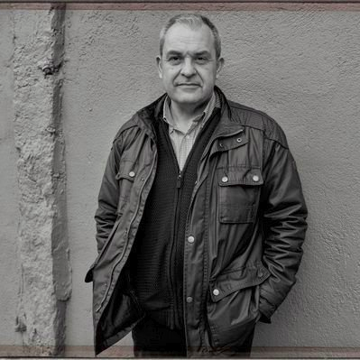

Slide 5
Ramón
Nicolas
Club de lectores' magazine and in the information pages of Galician books in the magazine 'Qué leer'. He collaborated in the programme 'Libro aberto' on Galician TV.
Since 1999 he has directed the collection Biblioteca das Letras Galegas of Edicións Xerais de Galicia and was awarded the prize for publishing cooperation in 2004, instituted by this publishing house for his work as a literary critic.

Slide 6
Ramón
Nicolas
He was rated in successive votes organised by the website "Fervenzas literarias" as best literary critic in 2008, 2009, 2010 and 2011; also his translation of 'Sete casas en Francia', by Bernardo Axtaga, was considered best book in the section of translation for adults in 2009 in the same website.
In 2011, his translation of '30 gramos', by Leonel Moura, was awarded the Lois Tobío Prize for the best translation in 2011 by the Galician Publishers' Association, and in the same year he also received the Prize of the Galician Language Writers' Association for the best career in cultural journalism.

Slide 7
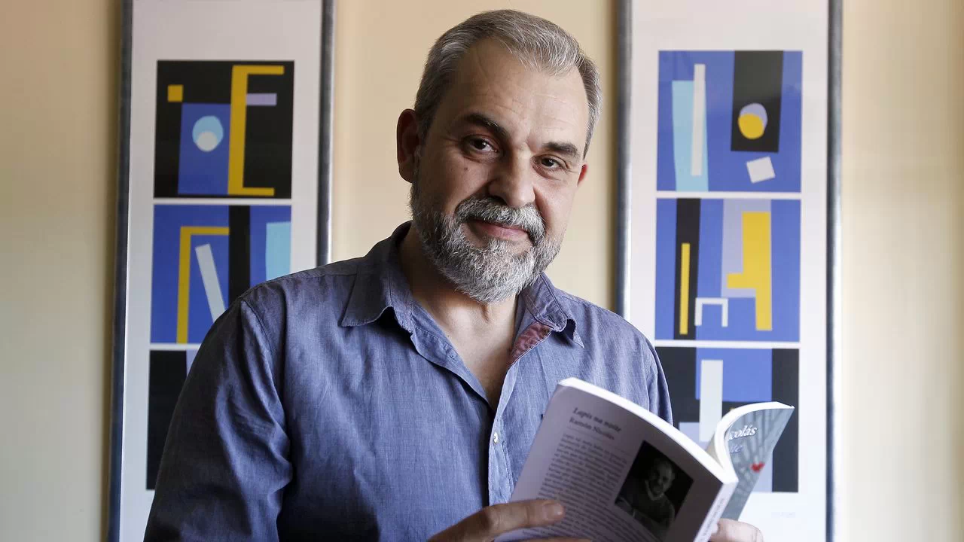
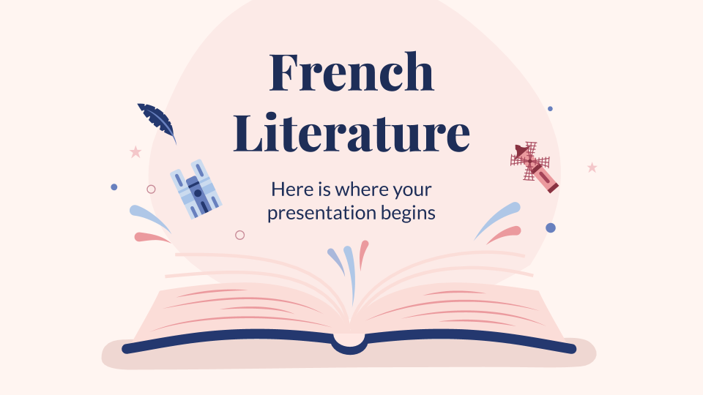
Achievements
In 2013, the Asociación de Escritores en Lingua Galega awarded him the prize for best blog -cadernodacritica.blogaliza.org- and best essay for his book 'Onde o mundo se chama Celso Emilio Ferreiro' (Xerais, 2012), a book that also won the Losada Diéguez Prize for the best essay published in 2012.

Slide 8
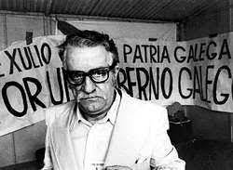
Since 2011 he has been a trustee of the Celso Emilio Ferreiro Foundation.

Slide 9
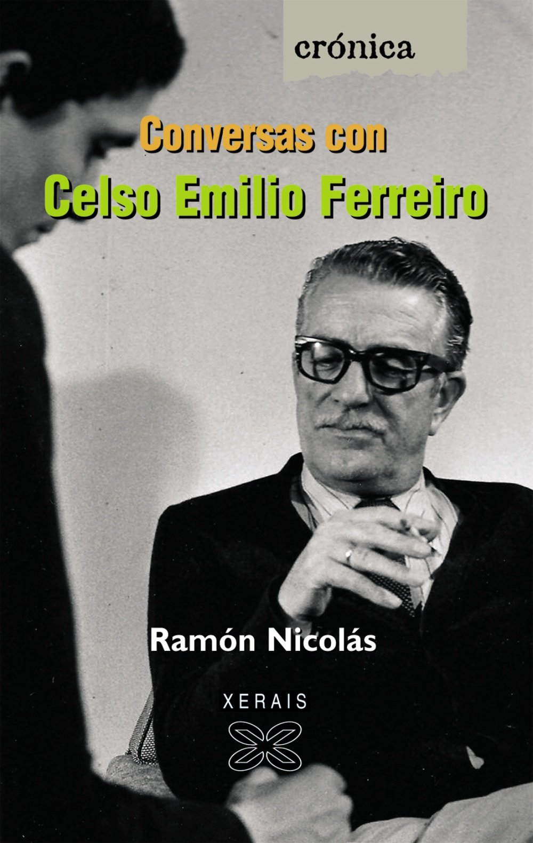
To give it shape, Ramón Nicolás compiled the interviews that the written media conducted with Celso Emilio Ferreiro throughout his life and ordered his answers based on thematic criteria (biographical questions, his work, literature in general, Galicia, Galician, politics...).
Conversas con Celso Emilio Ferreiro is the result of almost three years of work which, he explains, stems from a book of similar characteristics that he published 15 years ago about Álvaro Cunqueiro.

Slide 10
The book can be understood as a biography or as a book about what Celso Emilio Ferreiro thought about different aspects, explains the author.

Slide 11
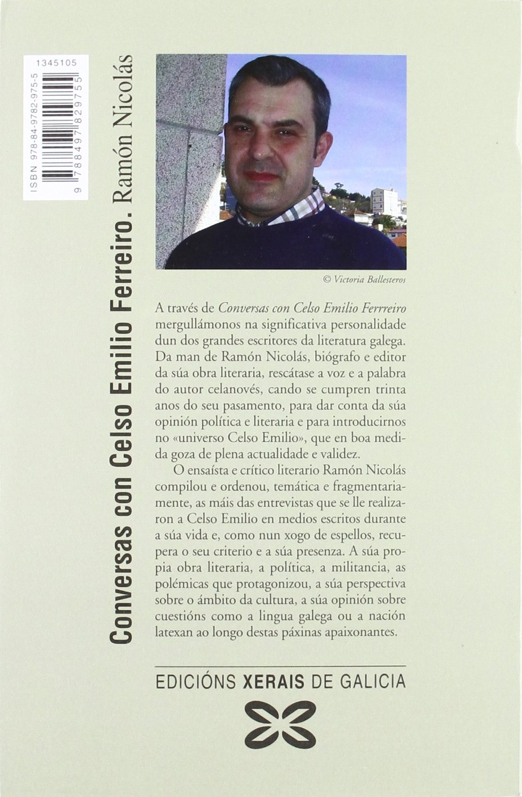
With this publication, the writer wanted to make his particular contribution to the year that marks the 30th anniversary of the death of Celso Emilio Ferreiro, although the fact that he had been working on him for years as a biographer of his poetry and work also played a role in his choice of Celso Emilio Ferreiro for his book.

