Slide 11
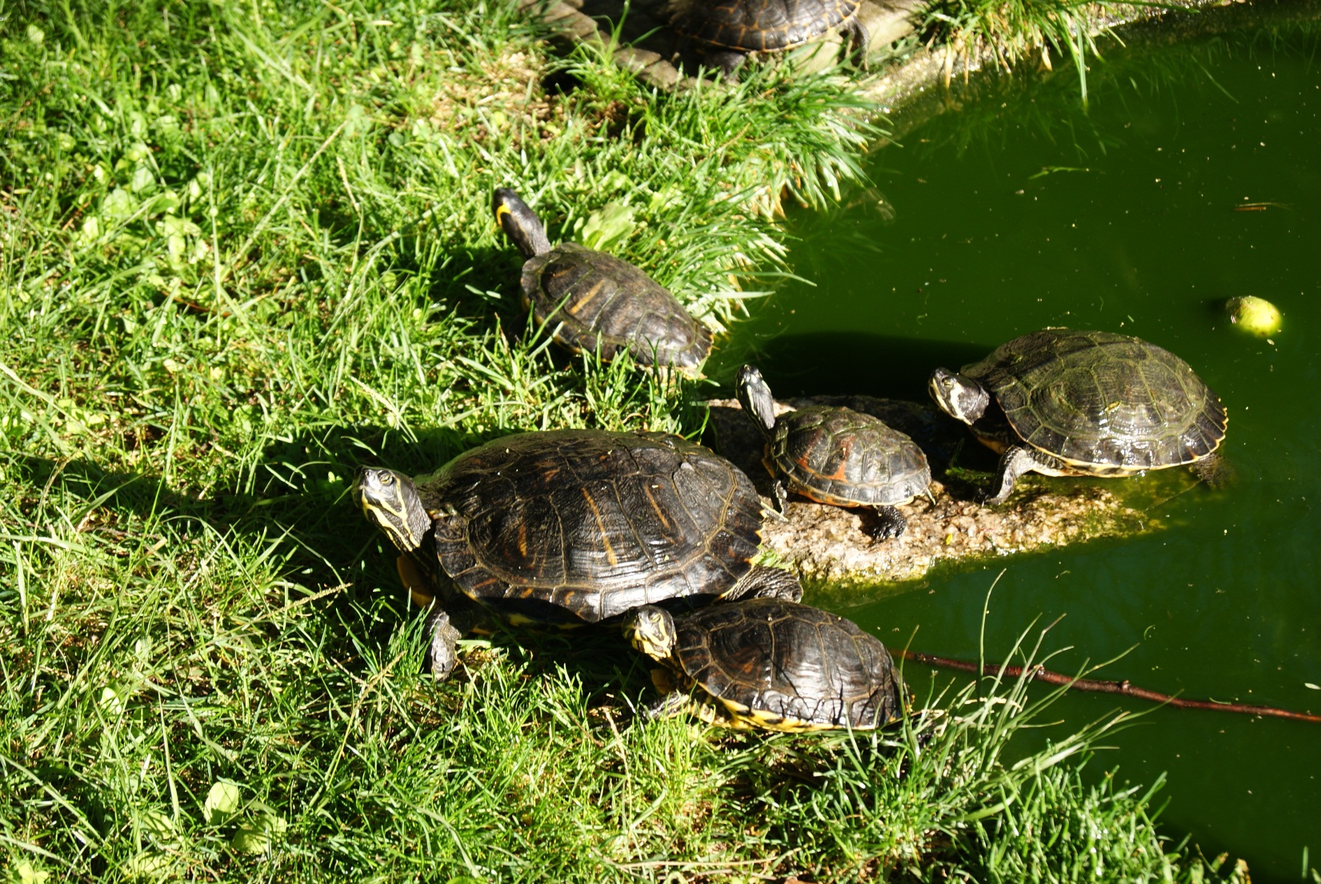
AS NOSAS
TARTARUGAS
DO COLE

